Slide 1
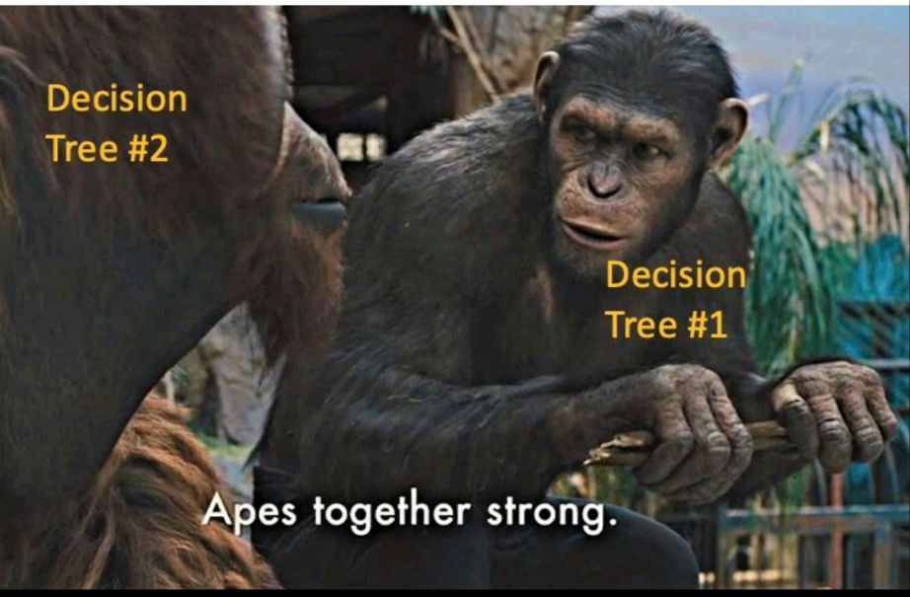
Ensemble of tree-based models

Slide 2
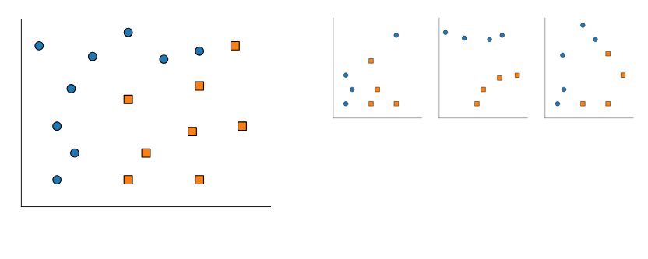
Part 1: bagging and random forests

Slide 3
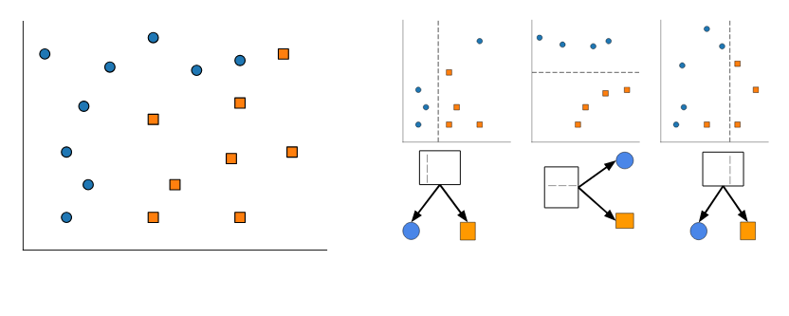

Slide 4
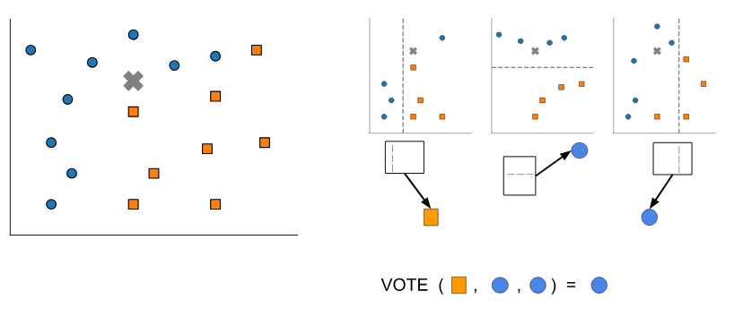

Slide 5
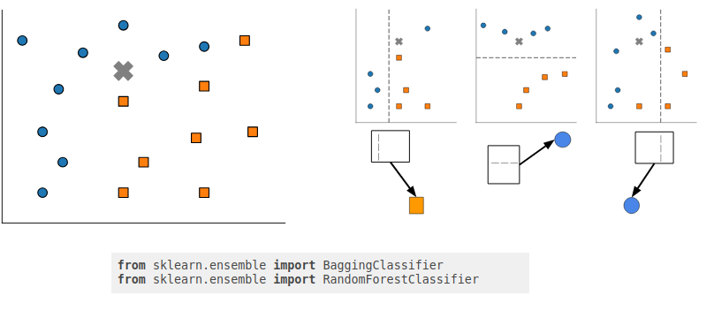

Slide 6
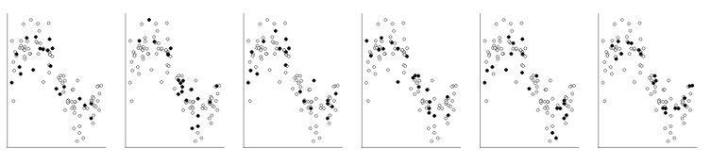
Bagging for regression
Select multiple random subsets of the data

Slide 7
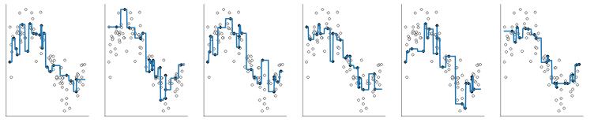
Bagging for regression
Select multiple random subsets of the data
Fit one model on each

Slide 8
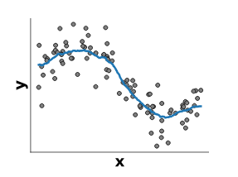
Bagging for regression
Select multiple random subsets of the data
Fit one model on each
Average predictions

Slide 9
Bagging versus Random Forests
Bagging is a general strategy
Can work with any base model (linear, trees...)
Random Forests are bagged randomized decision trees
At each split: a random subset of features are selected
The best split is taken among the restricted subset
Extra randomization decorrelates the prediction errors
Uncorrelated errors make bagging work better

